Slide 1
Murach’s Modern JavaScript
Chapter 10
How to work with web storage

Slide 2
Objectives
Applied
Set items in web storage and get items from web storage.
Use the nullish coalescing operator to provide a default value for an item in web storage.
Convert objects to and from the JSON format.
Use Chrome’s developer tools to view, add, edit, or delete items in web storage.
Knowledge
Distinguish between session cookies and persistent cookies.
Describe three differences between cookies and web storage.
Distinguish between session storage and local storage.

Slide 3
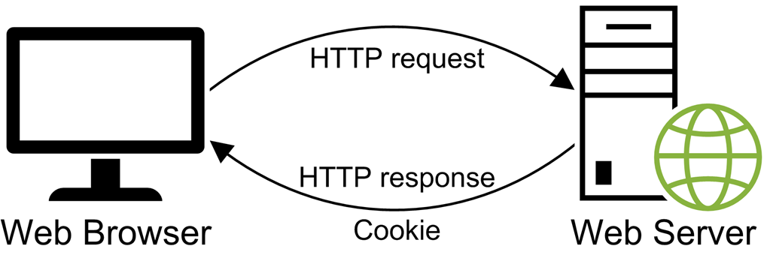
The server typically sets a cookie as part of an HTTP response

Slide 4
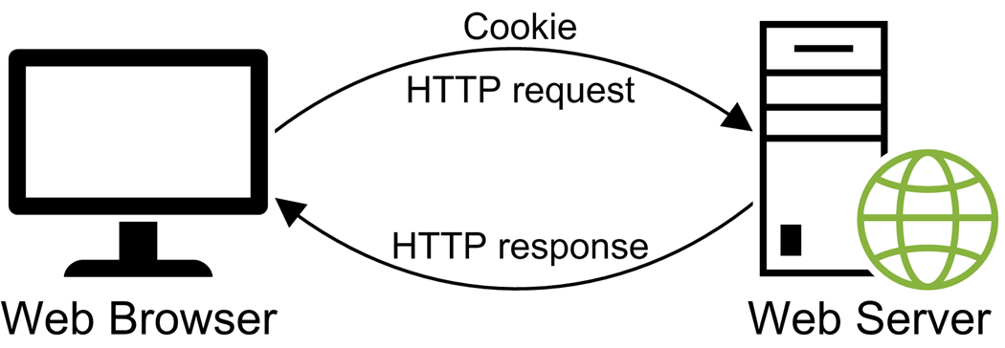
A browser sends the cookie back to the server with each HTTP request

Slide 5
Two attributes of a cookie
max-age
path
Cookie examples
username=ghopper; max-age=1814400; path=/
temp_id=12345; path=/
Cookie concepts
A cookie is a small text string that is stored by a web browser.
A cookie consists of name/value pairs.
A session cookie is deleted by the web browser when the browser is closed.
A persistent cookie is saved by the web browser and remains available even after the browser is closed. This type of cookie has an expiration date that is after the current date.

Slide 6
Set two cookies in the browser
document.cookie = "username=ghopper; max-age=1814400; path=/";
document.cookie = "temp_id=12345; path=/";
Get all cookies from the browser
const cookies = document.cookie;

Slide 7
Two objects for storing data in the browser
Object | Description
localStorage | Never expires. Can store up to 10MB of data.
sessionStorage | Expires when the browser is closed. Can store up to 5MB of data.

Slide 8
Web storage
Was designed to be accessed by client-side code.
Doesn’t send its data to the server with each HTTP request.
Can store up to 10MB of data.
Cookies
Were designed to be accessed by server-side code.
Send their data to the server with each HTTP request.
Can only store up to 4KB of data.

Slide 9
Methods for working with a web storage object
setItem(key, value)
getItem(key)
removeItem(key)
clear()
The shortcut syntax
key

Slide 10
Set and get an item with methods
localStorage.setItem("email", "grace@hopper.com");
const email = localStorage.getItem("email");
// email is "grace@hopper.com"
Set and get the same item with the shortcut syntax
localStorage.email = "grace@hopper.com";
const email = localStorage.email;
// email is "grace@hopper.com"

Slide 11
Remove the specified item from storage
localStorage.removeItem("email");
Remove all items from storage
localStorage.clear();

Slide 12
Set and get an item that’s a number
localStorage.score = 100;
const score = Number(localStorage.score);
// score is 100
Set and get an item that’s a date
localStorage.startDate = new Date("5/1/2024");
const startDate = new Date(localStorage.startDate);
const year = startDate.getFullYear();
// year is 2024
Set and get an item in session storage
sessionStorage.email = "grace@hopper.com";
const email = sessionStorage.email;
// email is "grace@hopper.com"

Slide 13
Provide a default value with an if statement
let email = "";
if (localStorage.email) {
email = localStorage.email;
}
Provide a default value with the nullish coalescing operator
const email = localStorage.email ?? "";

Slide 14
Use local and session storage for hit counters
let localHits = localStorage.hits ?? "0"; // get hits
localHits = Number(localHits) + 1; // increment by 1
localStorage.hits = localHits; // set hits to new value
let sessionHits = sessionStorage.hits ?? "0";
sessionHits = Number(sessionHits) + 1;
sessionStorage.hits = sessionHits;
console.log("Hits for this browser: " + localStorage.hits);
console.log("Hits for this session: " +
sessionStorage.hits);
Possible values for the hit counters when displayed on the console
Hits for this browser: 5
Hits for this session: 2

Slide 15
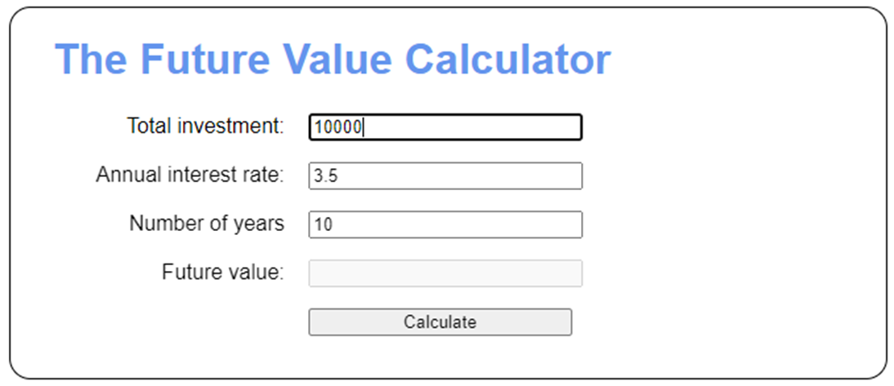
An app that remembers previous entries

Slide 16
Event handler for the DOMContentLoaded event
document.addEventListener("DOMContentLoaded", () => {
// load user entries
getElement("#investment").value =
localStorage.investment ?? "";
getElement("#rate").value =
localStorage.rate ?? "";
getElement("#years").value =
localStorage.years ?? "";
// attach the event handler
getElement("#calculate").addEventListener("click",
calcButtonClick);
// set focus on first text box on initial load
getElement("#investment").focus();
});

Slide 17
Some code in the event handler for the click event of the Calculate button
// if user entries are valid
if (errorMsg == "") {
// save user entries
localStorage.investment = investment;
localStorage.rate = rate;
localStorage.years = years;
// calculate and display future value
const futureValue =
calcFutureValue(investment, rate, years);
getElement("#future_value").value =
futureValue.toFixed(2);
} else {
// display error message
alert(errorMsg);
}

Slide 18
Two methods of the JSON object
stringify(object)
parse(json)
Convert an array to a JSON string
// create an array that contains two items
const tasks = [];
tasks.push("Finish current project");
tasks.push("Get specs for next project");
// convert array to JSON
const tasksJson = JSON.stringify(tasks);
// save JSON to web storage
localStorage.tasks = tasksJson;
The JSON string
["Finish current project","Get specs for next project"]

Slide 19
Convert a JSON string to an array
// get JSON from web storage
const tasksJson = localStorage.tasks;
// convert JSON to array
const tasks = JSON.parse(tasksJson);
// "Finish current project"
console.log(tasks[0]);
// "Get specs for next project"
console.log(tasks[1]);

Slide 20
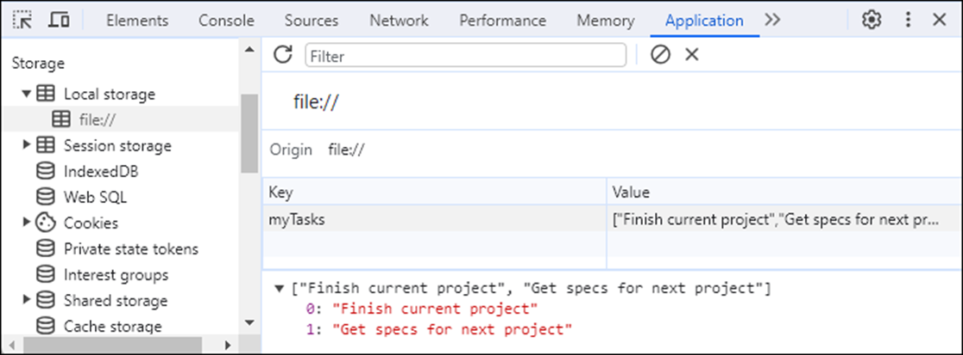
The local storage items for an app in the Application panel

Slide 21
Common tasks for working with stored items in the Application panel
View stored items
Delete stored items
Change the name of the key for a stored item
Change the value of a stored item
Add a key/value pair for a new stored item

Slide 22
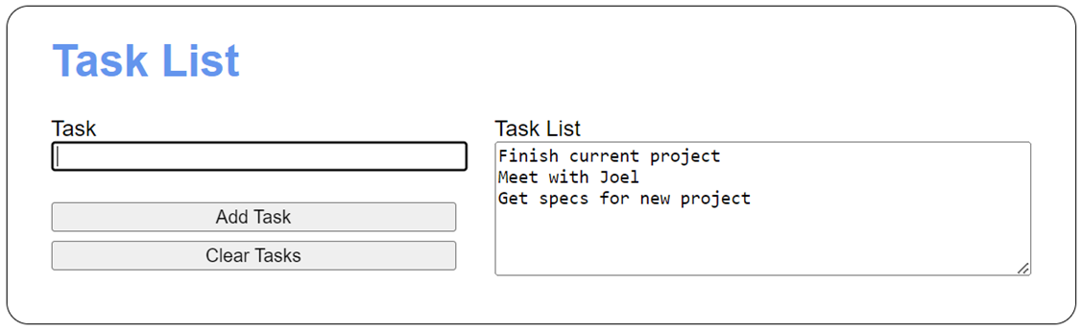
The Task List app

Slide 23
The HTML for the <body> element
<body>
<h1>Task List</h1>
<div id="tasks">
<label for="task_list">Task List</label><br>
<textarea id="task_list" rows="6" cols="50">
</textarea>
</div>
<div>
<label for="task">Task</label><br>
<input type="text" id="task">
</div>
<div>
<input type="button" id="add_task"
value="Add Task"><br>
<input type="button" id="clear_tasks"
value="Clear Tasks">
</div>
<script src="task_list.js"></script>
</body>

Slide 24
CSS for the <div> element with “tasks” as its id
#tasks {
margin-top: 0;
float: right;
}

Slide 25
The JavaScript for the Task List app (part 1)
const getElement = selector =>
document.querySelector(selector);
const getDisplayString = tasks => {
if (tasks.length === 0) {
return "";
} else {
return tasks.join("\n");
}
};
document.addEventListener("DOMContentLoaded", () => {
// get tasks array from web storage
const tasksStr = localStorage.myTasks ?? null;
const tasks = JSON.parse(tasksStr) ?? [];
// display tasks on initial load
getElement("#task_list").value =
getDisplayString(tasks);
getElement("#task").focus();

Slide 26
The JavaScript for the Task List app (part 2)
getElement("#add_task").addEventListener(
"click", () => {
const textbox = getElement("#task");
const task = textbox.value;
if (task === "") {
alert("Please enter a task.");
textbox.focus();
} else {
// add task to web storage
tasks.push(task);
localStorage.myTasks = JSON.stringify(tasks);
// clear task text box and re-display tasks
textbox.value = "";
getElement("#task_list").value =
getDisplayString(tasks);
textbox.focus();
}
});

Slide 27
The JavaScript for the Task List app (part 3)
getElement("#clear_tasks").addEventListener(
"click", () => {
// clear tasks array and web storage
tasks.length = 0;
localStorage.removeItem("myTasks");
getElement("#task_list").value = "";
getElement("#task").focus();
});
});

